Slide 1
Model fitting and checking
蒋智超
2025年 秋

Slide 2
Motivation
We have learnt estimation and inference under a specified model
But, does the model fit well for the data?
How robust is the result?

Slide 3
Residual plots：heuristic diagnostics
Residual plots: residuals vs. fitted values
Linearity: violated if residuals show systematic curvature
Homoskedasticity: violated if residuals fan out or narrow down with fitted values
Normality: Q-Q plots of residuals
Outliers: talk about this later

Slide 4
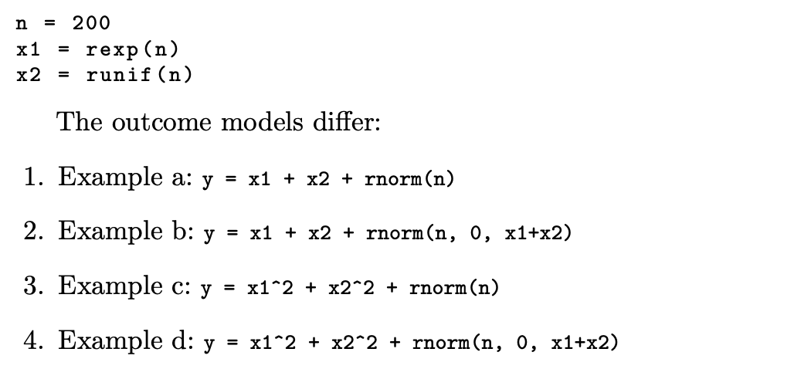
Residual plots: example

Slide 5
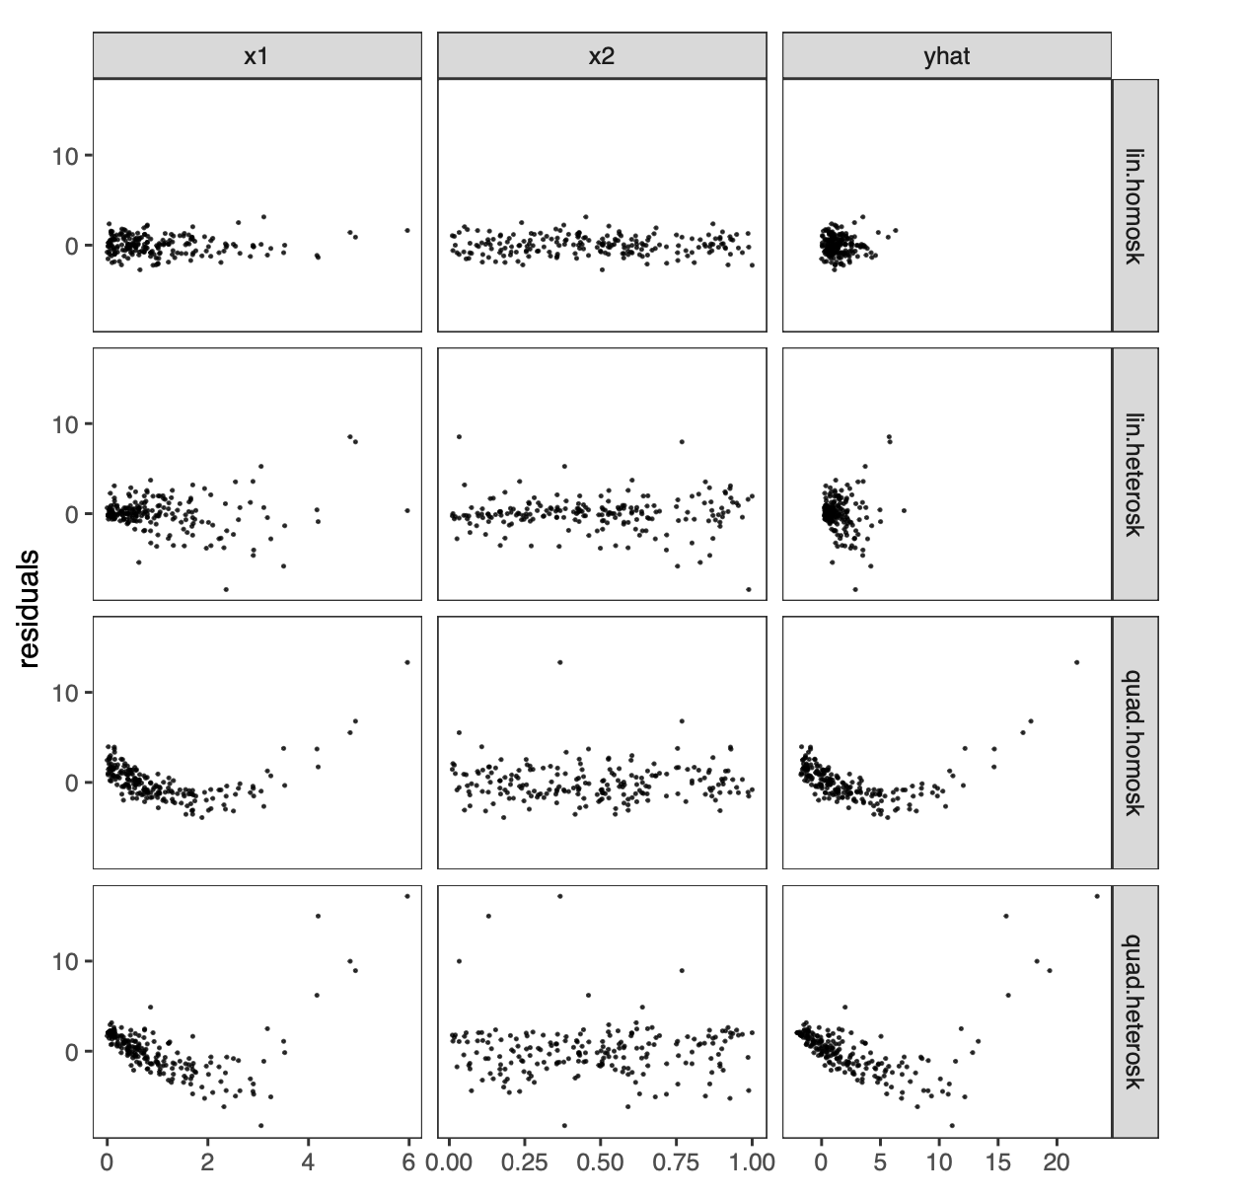

Slide 6
Multiple correlation coefficient
Pearson correlation coefficient measures the correlation between two scalars
Multiple correlation coefficient
Measures the correlation between a scalar outcome and a vector covariate
Measures how well multiple covariates can linearly represent an outcome

Slide 7
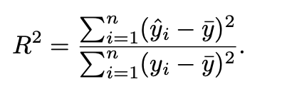
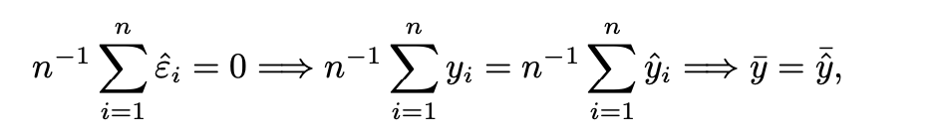
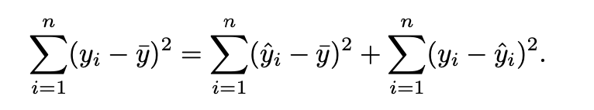


Equivalent definitions of $R^{2}$
$X$ excludes the column of 1’s in this part
$R^{2}$: Percentage of variance explained by $X$
Based on the regression of $Y$on $(1_{n},X)$
Total sum of squares = regression sum of squares + residual sum of squares
Notes:
Homework: Proof of the variance decomposition

Slide 8
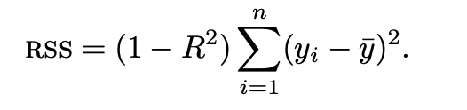
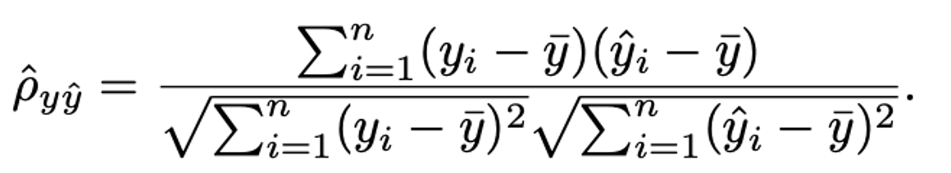


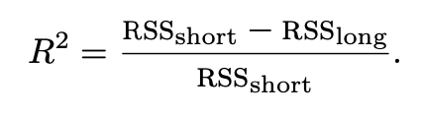

Equivalent definitions of $R^{2}$
Residual sum of squares
$R^{2}={{\hat{ρ}}^{2}}_{y\hat{y}}$
Based on the regression of $Y$on $(1_{n},X)$
Long regression
Short regression
Notes:
Homework: Proof of the second equality

Slide 9
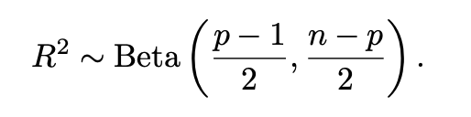

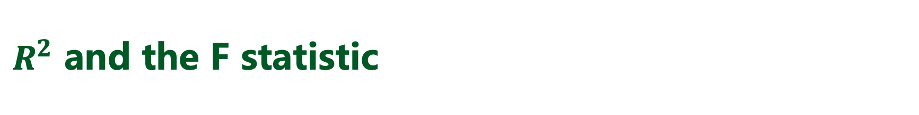
$R^{2}$ and the F statistic
Normal linear model $Y=1_{n}β_{0}+Xβ+ε, ε∼N(0,σ^{2}I_{n})$
$H_{0}:β=0$
$F=\frac{({RSS}_{short}−RRS_{long})/(p−1)}{RSS_{long}/(n−p)}$
$F=\frac{n−p}{p−1}×\frac{R^{2}}{1−R^{2}}$
Under $H_{0}$,
Notes:
Relationship between chisq Gamma and Beta distributions

Slide 10

多选题
1分
Which are correct?
A
R² is a measure of the influence of covariates on the resposne variable.
B
R² *100 percent of the variation in $Y$ is reduced by taking into account predictors $x$.
C
R² *100 percent of the variation in $Y$ is accounted for by the variation in predictors $x$.
D
A high R² means that the estimated regression line fits the data well.
E
A high R² is a proof that a correct model has been specified.
F
A model with higher R² is better than another model with a lower R².
提交

Slide 11
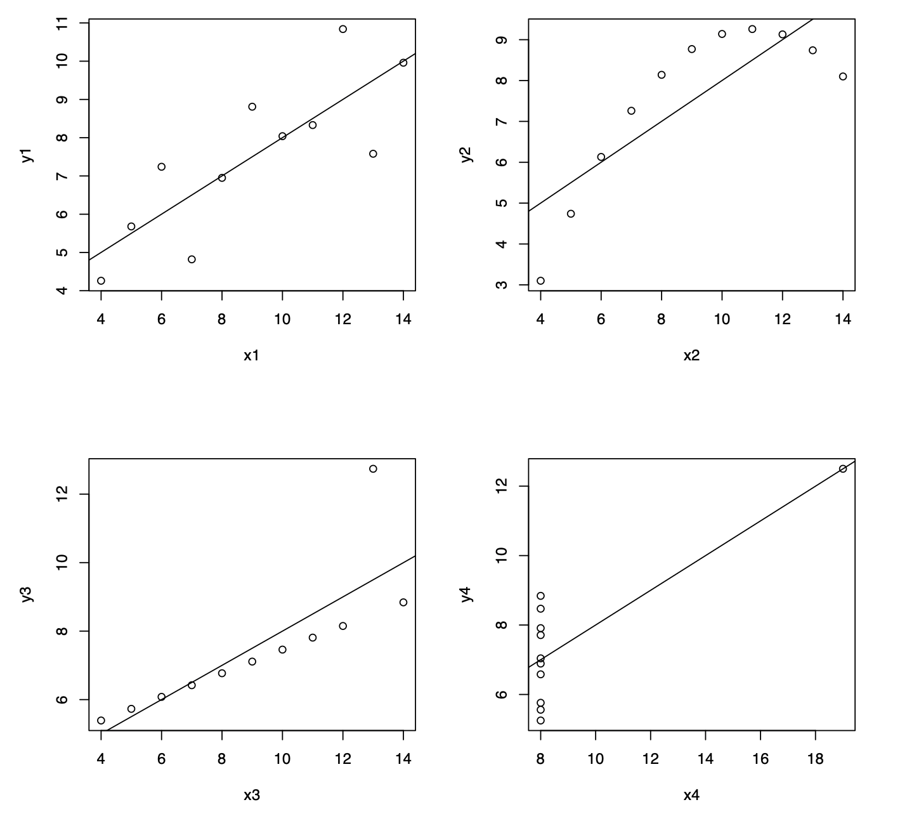
Anscombe’s Quartet

Slide 12

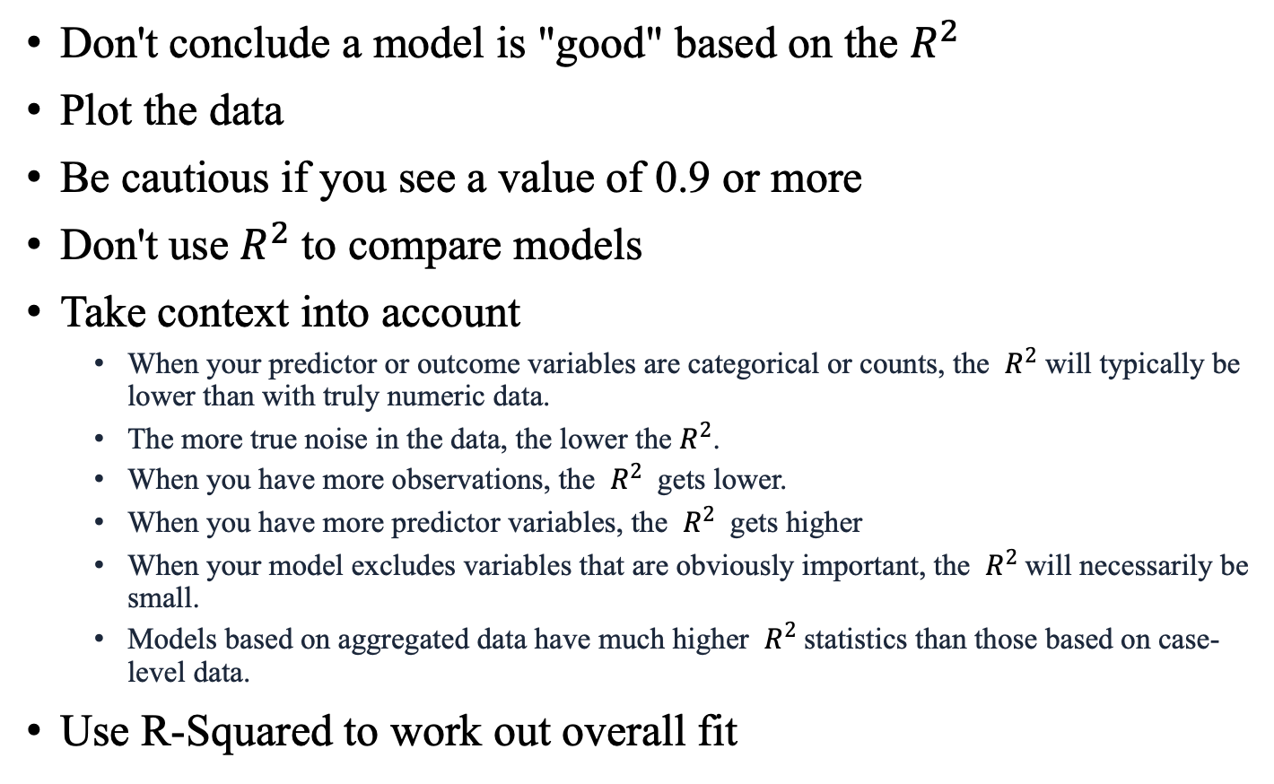
Some remarks on $R^{2}$
Don't conclude a model is "good" based on the $R^{2}$
Plot the data
Be cautious if you see a value of 0.9 or more
Don't use $R^{2}$ to compare models
Take context into account
When your predictor or outcome variables are categorical or counts, the $R^{2}$ will typically be lower than with truly numeric data.
The more true noise in the data, the lower the $R^{2}$.
When you have more observations, the $R^{2}$ gets lower.
When you have more predictor variables, the $R^{2}$ gets higher
When your model excludes variables that are obviously important, the $R^{2}$will necessarily be small.
Models based on aggregated data have much higher $R^{2}$statistics than those based on case-level data.
Use R-Squared to work out overall fit

Slide 13
多选题
1分
If we duplicate the data, which of the following will change?
A
OLS estimate
B
Variance estimate under homoskedasticity
C
EHW variance estimate
D
$P$ value of each OLS estimate
E
$$R^{2}$$
F
F statistic reported in the summary
提交

Slide 14
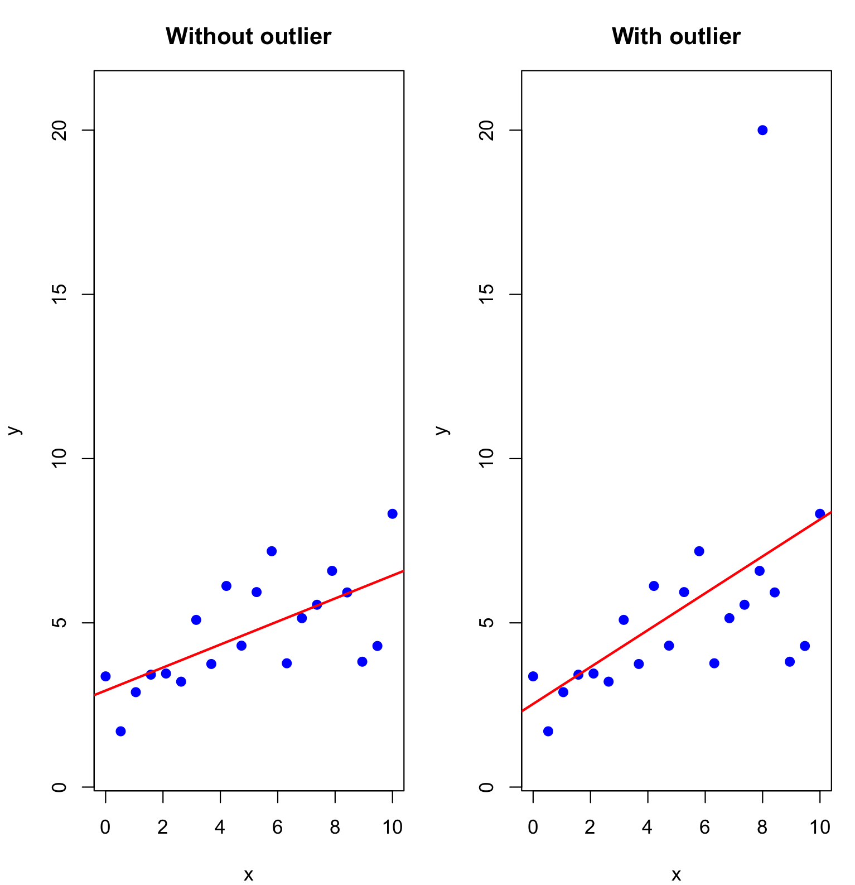
Leverage scores
More detailed investigation of the OLS
Measures whether a unit is an outlier
Measures how each unit affect the OLS estimates

Slide 15
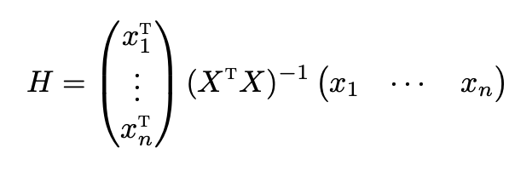

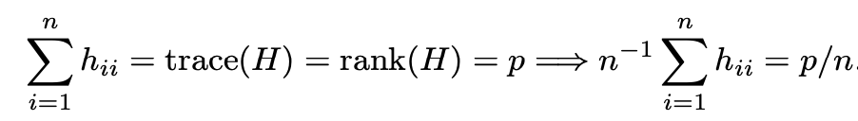
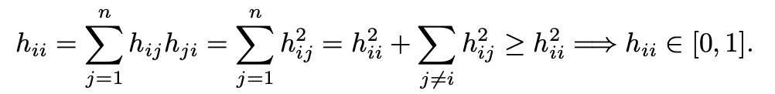
Leverage scores
Hat matrix
Leverage score
Average of leverage scores
Range

Slide 16
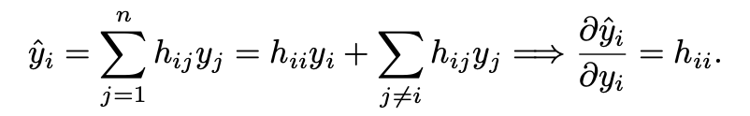
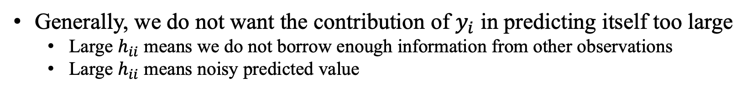
Leverage scores
Generally, we do not want the contribution of $y_{i}$ in predicting itself too large
Large $h_{ii}$ means we do not borrow enough information from other observations
Large $h_{ii}$ means noisy predicted value

Slide 17



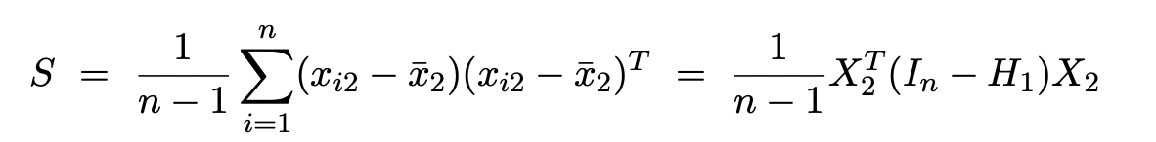



Leverage scores
$h_{ii}$ measures whether observation $i$ is an outlier based on its covariate value $x_{i}$
Mahalanobis distance between $x_{i2}$ and the center ${\overline{x}}_{2}$
Notes:
Sometimes people use sample variance for S

Slide 18
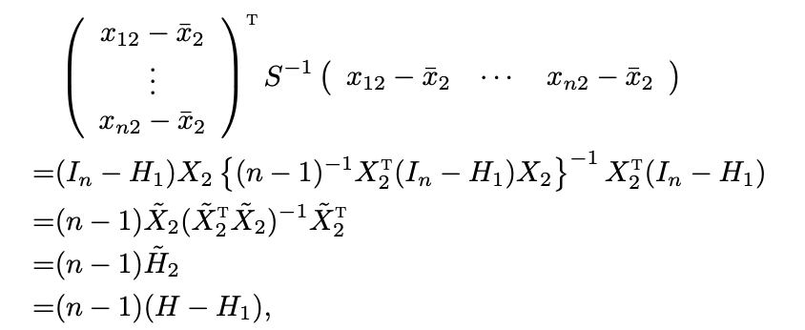
Leverage scores
Proof of
Notes:
Another advanced result on the leverage scores is due to Huber (1973). He proved that in the linear model with non-Normal IID εi ∼ [0,σ2] and σ2 < ∞, all linear combinations of the OLS coefficient are asymptotically Normal if and only if the maximum leverage score converges to 0.

Slide 19
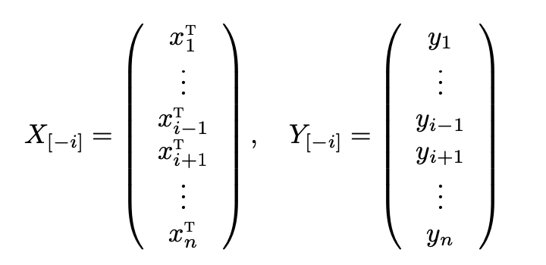

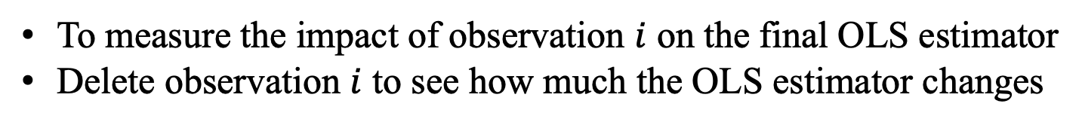
Leave-one-out formulas
To measure the impact of observation $i$ on the final OLS estimator
Delete observation $i$ to see how much the OLS estimator changes
Computational intensive to calculate the leave-one-out OLS estimator
for every observation

Slide 20

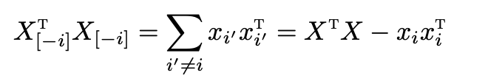
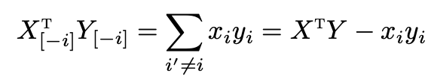
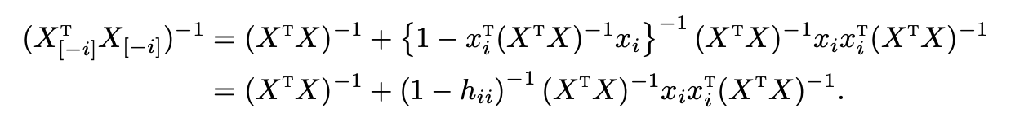

Leave-one-out formulas
If $h_{ii}≠1$
Proof
Sherman-Morrison Formula
Notes:
Homework: what if h_{ii}=1

Slide 21
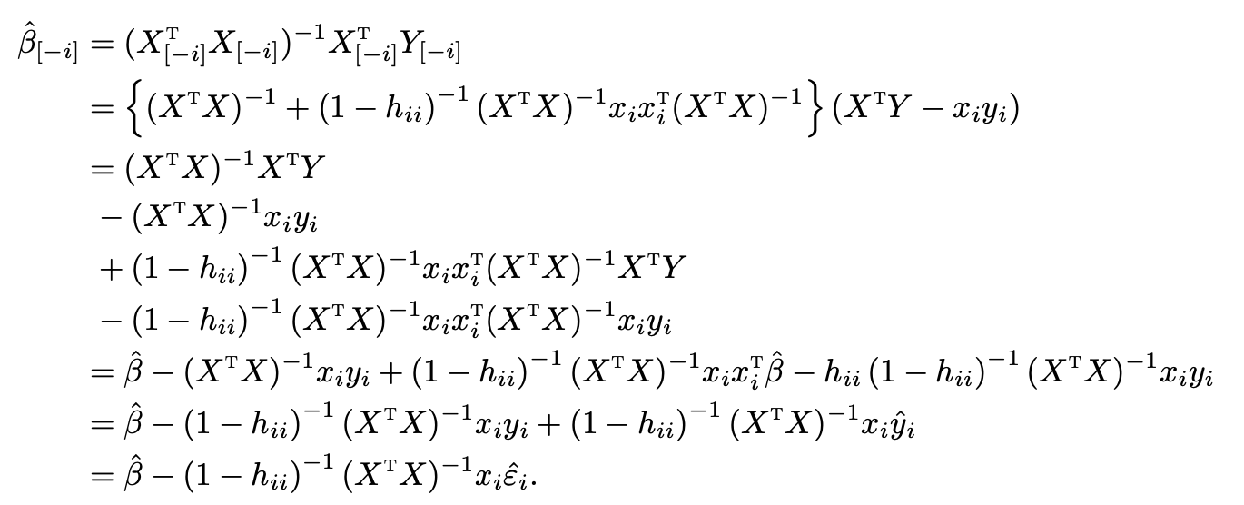
Leave-one-out formulas

Slide 22


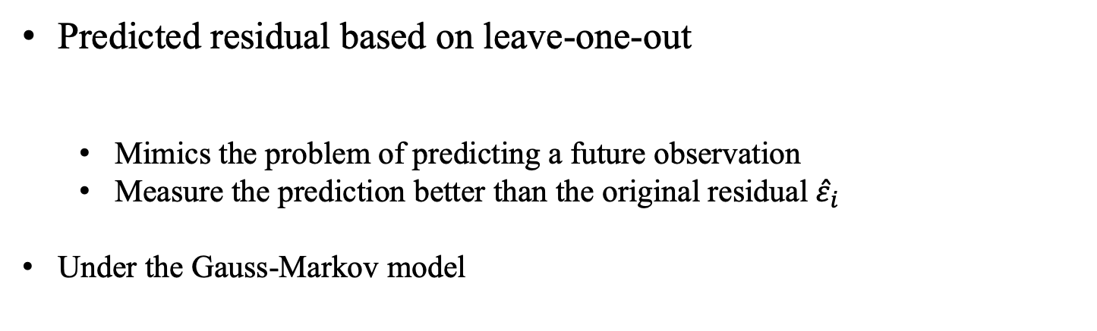
Leave-one-out formulas
Predicted residual based on leave-one-out
Mimics the problem of predicting a future observation
Measure the prediction better than the original residual ${\hat{ε}}_{i}$
Under the Gauss-Markov model

Slide 23


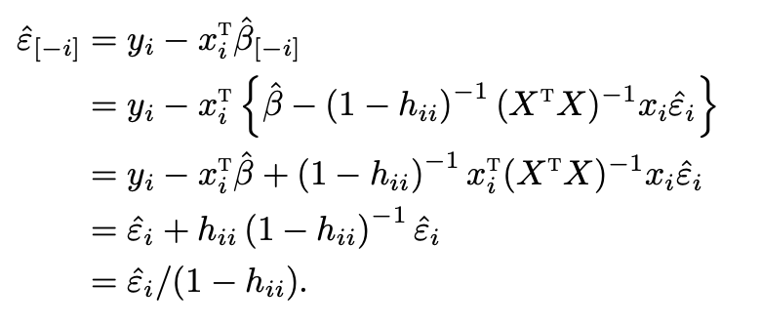
Leave-one-out formulas
Under the Gauss-Markov model
Proof:

Slide 24
Applications of leave-one-out formulas
Gauss updating formula
Outlier detection
Jackknife

Slide 25
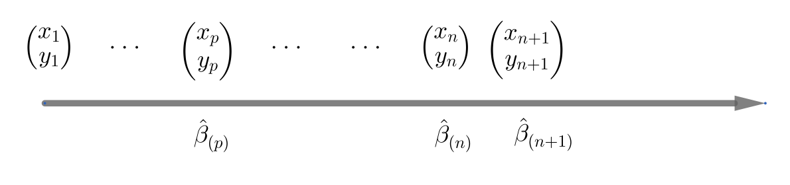
Gauss updating formula
Consider an online setting where data points come sequentially
Update the OLS estimator with an additional data point

Slide 26



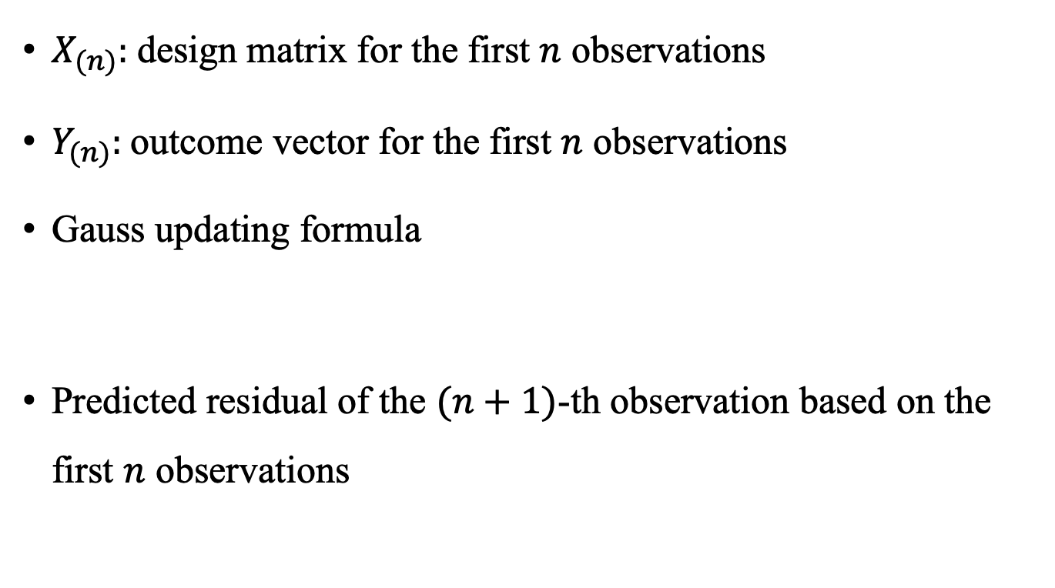
Gauss updating formula
$X_{(n)}:$design matrix for the first $n$ observations
$Y_{(n)}:$outcome vector for the first $n$ observations
Gauss updating formula
Predicted residual of the $(n+1)$-th observation based on the first $n$ observations

Slide 27
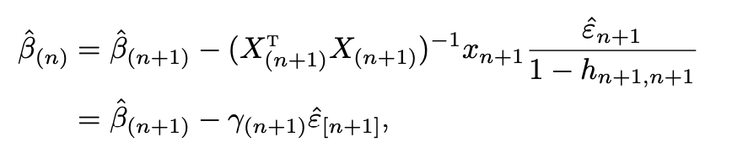
Gauss updating formula
Proof:
Reverse of the leave-one-out formula
Notes:
to obtain βˆ(n+1) from βˆ(n), the adjustment depends on the predicted residual εˆ[n+1]. If we have perfect prediction of the
(n+1)th observation based on βˆ(n), then we do not need to make any adjustment to obtain βˆ(n+1); if the predicted residual is large, then we need to make a large adjustment.

Slide 28
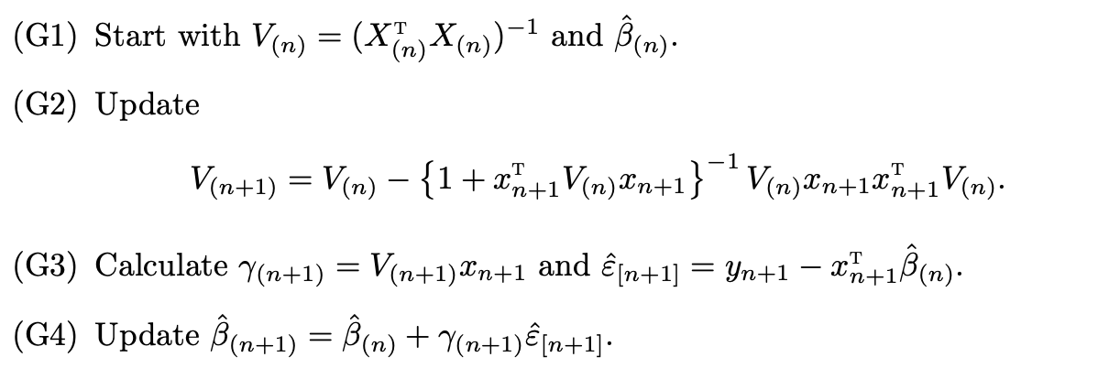
Algorithm for sequentially computing the OLS
Use the Sherman-Morrison formula to update the inverse of $X_{(n+1)}^{T}X_{(n+1)}$ based on the inverse of $X_{(n)}^{T}X_{(n)}$

Slide 29

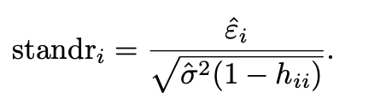
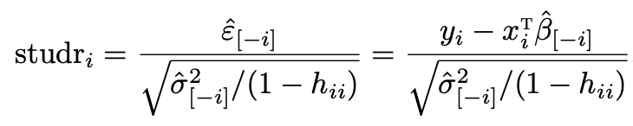

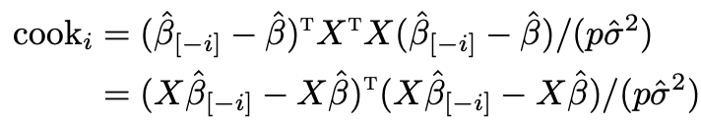
Outlier detection based on residuals
Assume the Normal linear model
Residual should follow a Normal distribution with
Model checking based on residuals
Standardized residual
Studentized residual
Cook’s distance
Notes:
Standardized residual is sometimes called internally studentized residual, and the studentized residual is externally studentized residual.

Slide 30
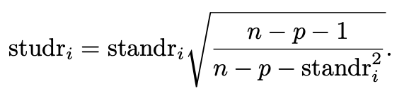
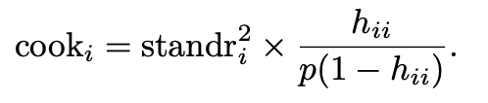
Outlier detection based on residuals
Rule of thumb for outlier detection
standardized and studentized residuals should fall between -3 and 3
A relatively large cook’s distance, on the order of 1, occurs when both
standardized residual and the leverage are relatively large
Recommend using studentized residual since it has a known distribution
under the Normal linear model
Notes:
Homework: Relationship

Slide 31
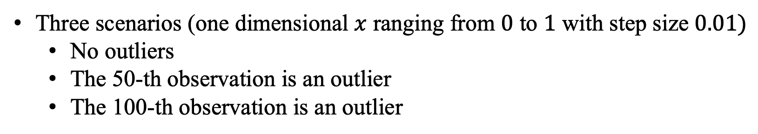
Simulation
Three scenarios (one dimensional $x$ ranging from $0$ to $1$ with step size $0.01)$
No outliers
The 50-th observation is an outlier
The 100-th observation is an outlier
Measures for outlier detection
Leverage score
Standardized residual
Studentized residual
Cook’s distance

Slide 32
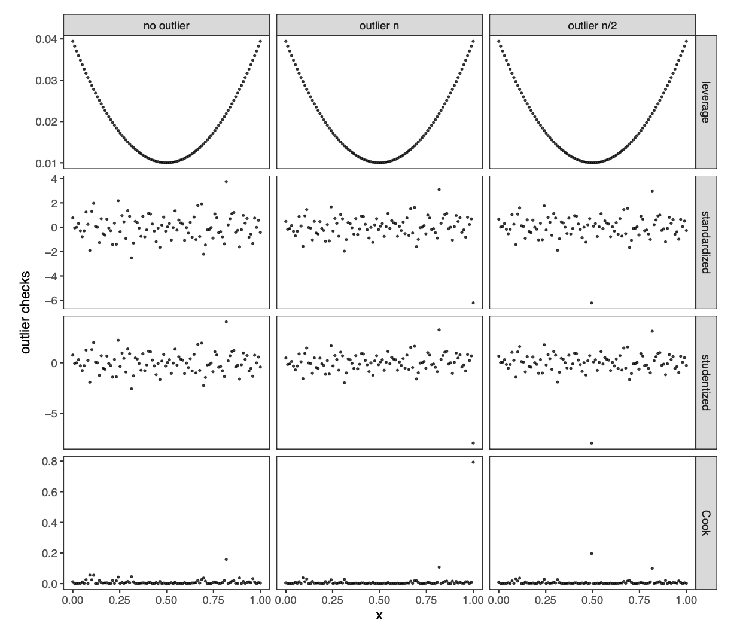
Simulation
Notes:
Although the outliers detection methods above are very classic, they are rarely implemented in modern data analyses. They are simple and useful diagnostics. I recommend using them at least as a part of the exploratory data analysis.

Slide 33
多选题
1分
Which of the following are the appropriate ways to handle an outlier
A
Remove it to improve the model fit
B
Keep it in the model only if it improves $R^{2}$
C
Investigate its cause before deciding whether to keep or remove it
D
Remove it, as outliers violate regression assumptions
提交

Slide 34
多选题
1分
What are the possible next step if you find outliers but you cannot or should not remove them?
A
Proceed with the analysis as usual and ignore the outliers, since they are valid data.
B
Use robust regression methods that down-weight the influence of outliers.
C
Replace the outlier values with the mean to reduce their impact.
D
Justify their inclusion and report how your conclusions are affected by them.
E
Specify a different model.
提交

Slide 35



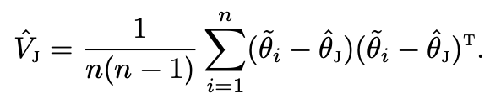

Jackknife
A general strategy for bias reduction and variance estimation
Proposed by Quenouille (1949,1956) and popularized by Tukey (1958)
Estimator without observation $i$
Pseudo value
Jackknife point estimator
Jackknife variance estimator
Notes:
Jackknife leads to the development of Bootstrap

Slide 36
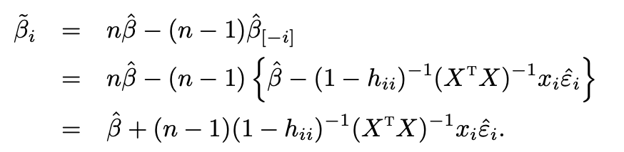
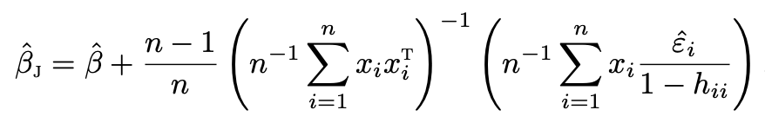


Jackknife in OLS

Slide 37

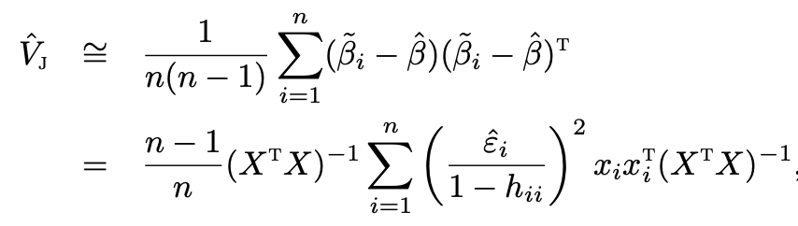
Jackknife in OLS
Approximate jackknife variance estimator by assuming
Miller (1974) first analyzed Jackknife in OLS
Hinkley (1977) modified the original Jackknife and proposed a version that is identical to HC1
Wu (1986) made some further modification and proposed a version that is identical to HC2
Weber (1986) made connections between EHW and jackknife standard errors
Long and Ervin (2000)’s finite-sample simulation seems to favor the original jackknife or HC3

